Slide 1

Week-2
Lecture 1

Slide 2
Classes and Objects

Slide 3
Lecture Contents
Class declaration
Creating Objects
Accessing Object Members
Defining Member Functions

Slide 4
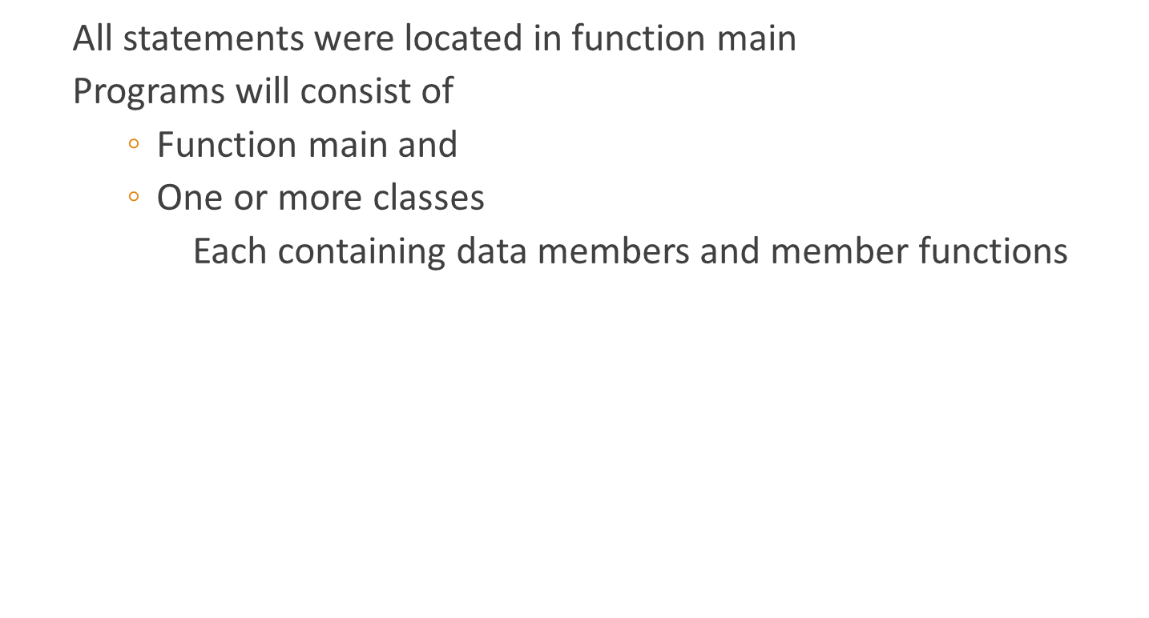
Class declaration
A class definition begins with the keyword class.
The body of the class is contained within a set of braces, { } ;
(notice the semi-colon).
class class_name
{
….
….
….
};
Any valid identifier
Class body (data member + methods)

Slide 5
Class declaration
class Circle
{
//property
double radius;
// Methods
void setRadius(double r);
double getDiameter();
double getArea();
double getCircumference();
};

Slide 6
Creating Objects
Declaring a variable of a class type creates an object.
You can have many variables of the same type (class).
  Instantiation
Once an object of a certain class is instantiated, a new memory location is created for it to store its data members and code

Slide 7
Creating Objects
You can instantiate many objects from a class type.
  Example
  Circle c; Circle *c;

Slide 8
Accessing Object Members
Operators to access class members
  Identical to those for structs
  Dot member selection operator (.)
    Object
    Reference to object
  Arrow member selection operator (->)
    Pointers

Slide 9
Accessing Object Members
void main(){
Circle c1;
Circle *c2 = new Circle();
c1.raduis = 5; //c2->radius=5; OR
c1.setRadius(5); //c2->setradius(5)
cout<<“The area of c1:” <<c1.getArea()<<“\n”; //c2->getArea();
cout<<“The circumference of c1:”<<c1.getCircumference()<<“\n”;
//c2->getCircumference();
cout<<“The Diameter of c2:”<<c2.getDiameter()<<“\n”;
//c2->getDiameter();
}

Slide 10
Defining Member Functions
Class implementation: writing the code of class methods.
There are two ways:
  Member functions defined outside class
    Binary scope resolution operator (::) to tie each member function outside class to the class definition
    Would be discussed in detail in next lecture

Slide 11
Defining Member Functions
Member functions defined inside class
  Do not need scope resolution operator, class name;
Defined inside class
class Circle
{
double radius;
void setRadius(double r){radius = r;}
double getDiameter(){ return radius *2;}
double getArea();
double getCircumference();
};

Slide 12
Defining Member Functions
class Circle {
double radius;
void setRadius(double r){radius = r;}
double getDiameter(){ return radius *2;}
double getArea() {
return radius * radius * (22.0/7);
}
double getCircumference() {
return 2 * radius * (22.0/7);
}
};

Slide 13
Defining Member Functions
class Circle {
double radius;
void setRadius(double r){radius = r;}
double getDiameter(){ return radius *2;}
double getArea();
double getCircumference();
};
double Circle::getArea() {
return radius * radius * (22.0/7);
}
double Circle:: getCircumference() {
return 2 * radius * (22.0/7);
}

Slide 14
Thank You

